Slide 1
Bifold test results
DSR Corporation

Slide 2
Agenda
Why were we testing?
What were we testing?
Results
Next steps

Slide 3
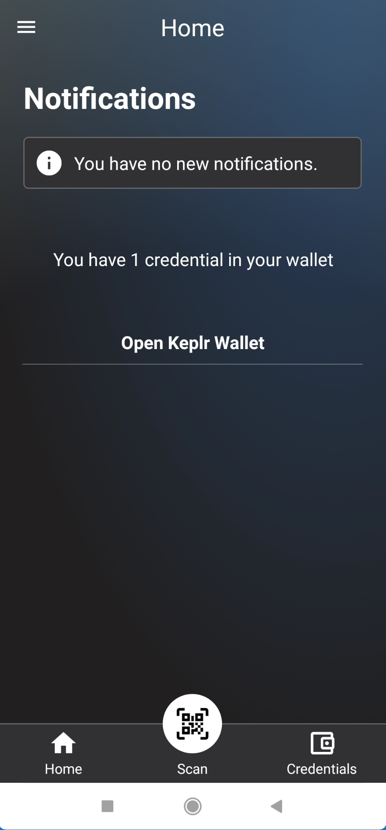
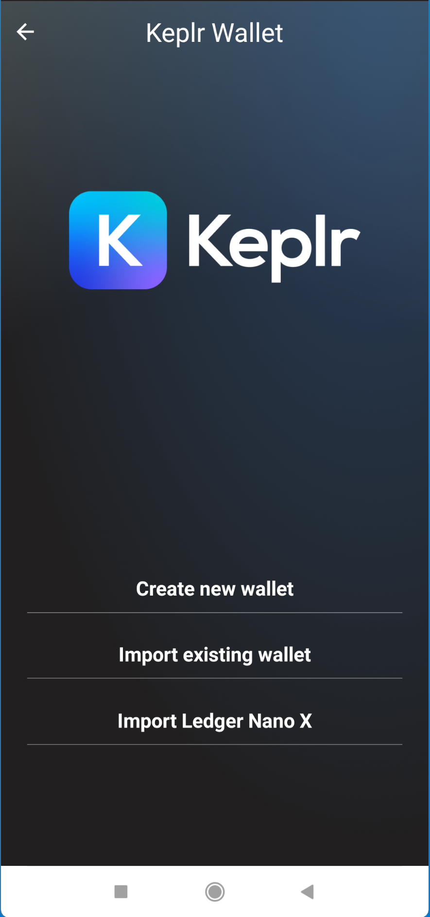
Why were we testing?
Notes:
Edit images: No
The images are taken from the specifications (see references)

Slide 4
What were we testing?

Slide 5
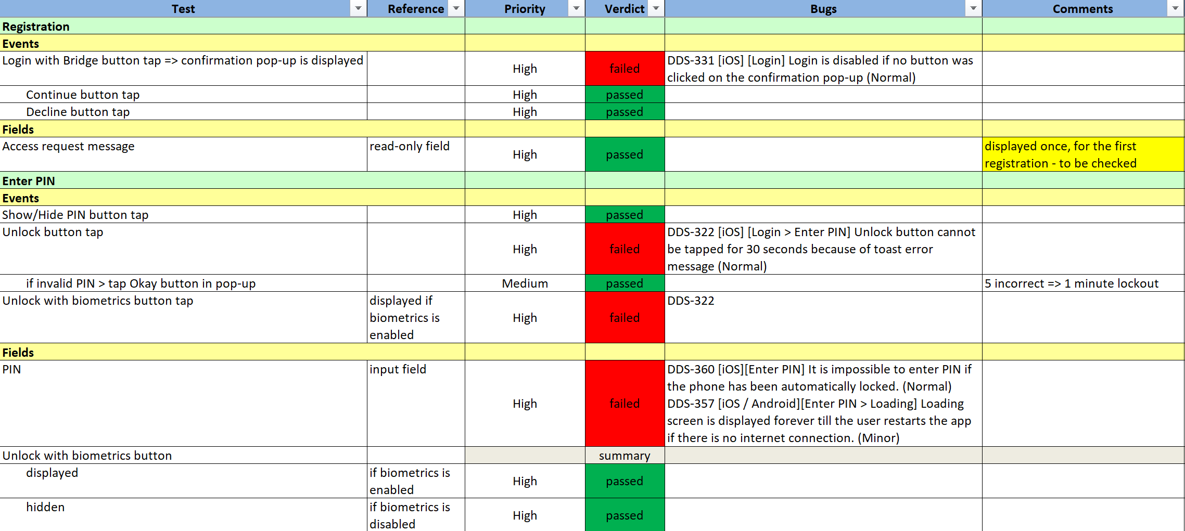
Registration

Slide 6
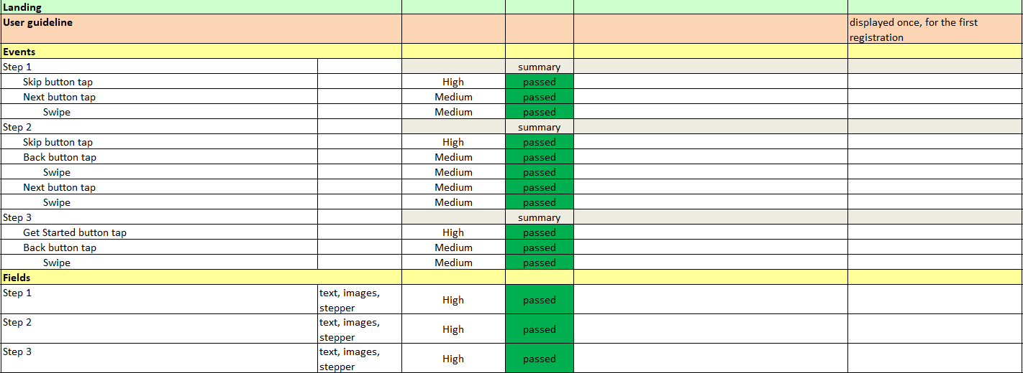
Onboarding - User guideline

Slide 7
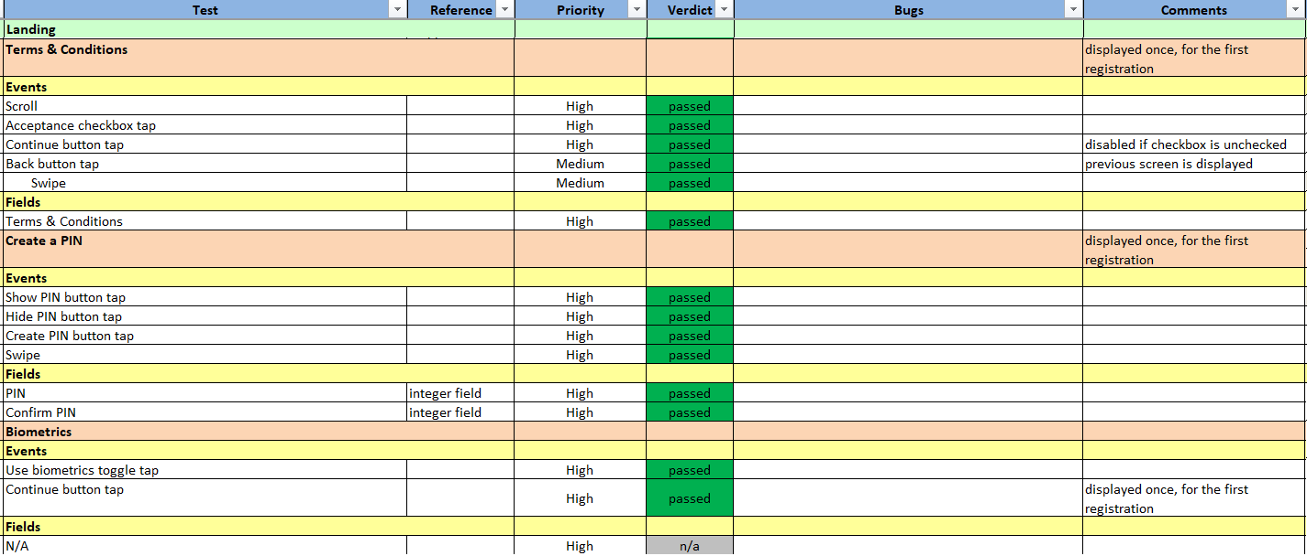
Onboarding

Slide 8
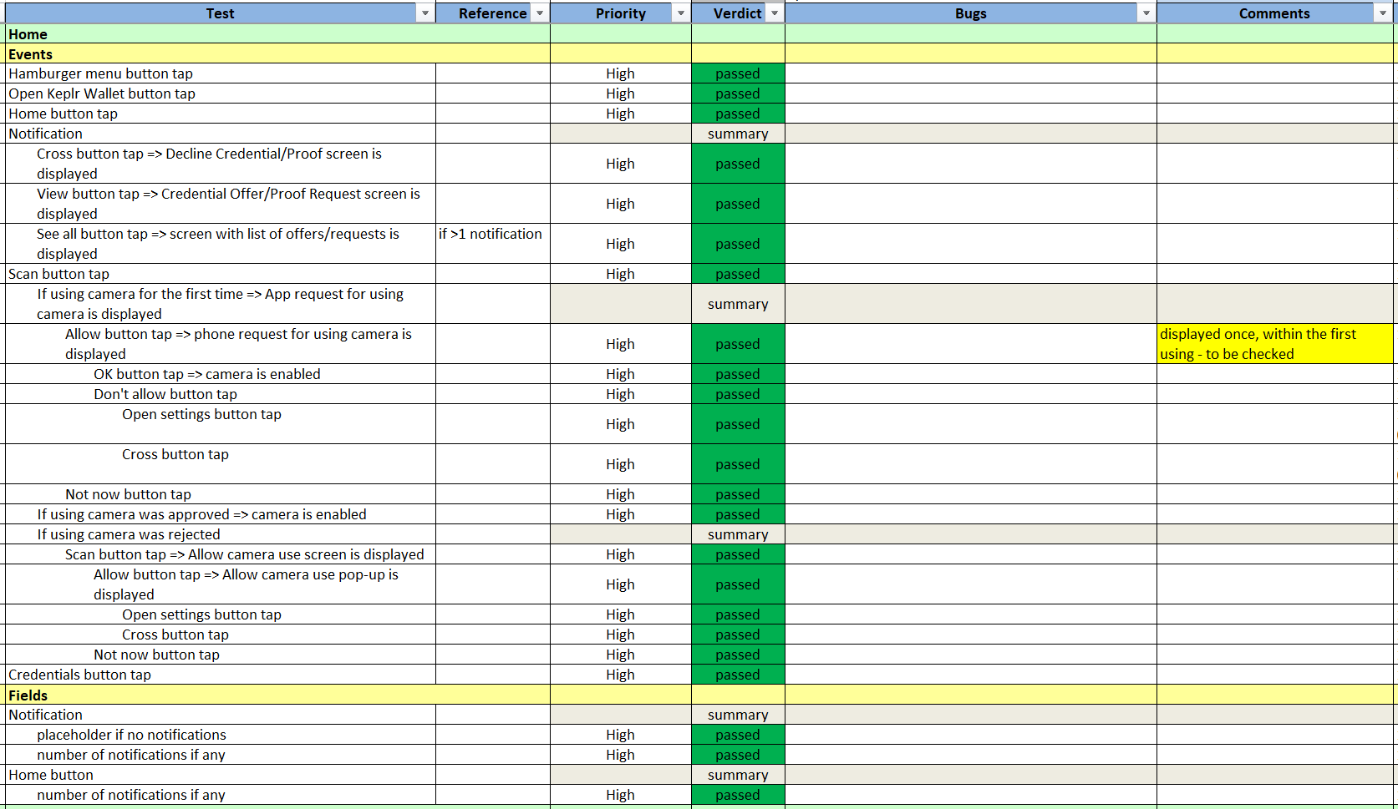
Home

Slide 9
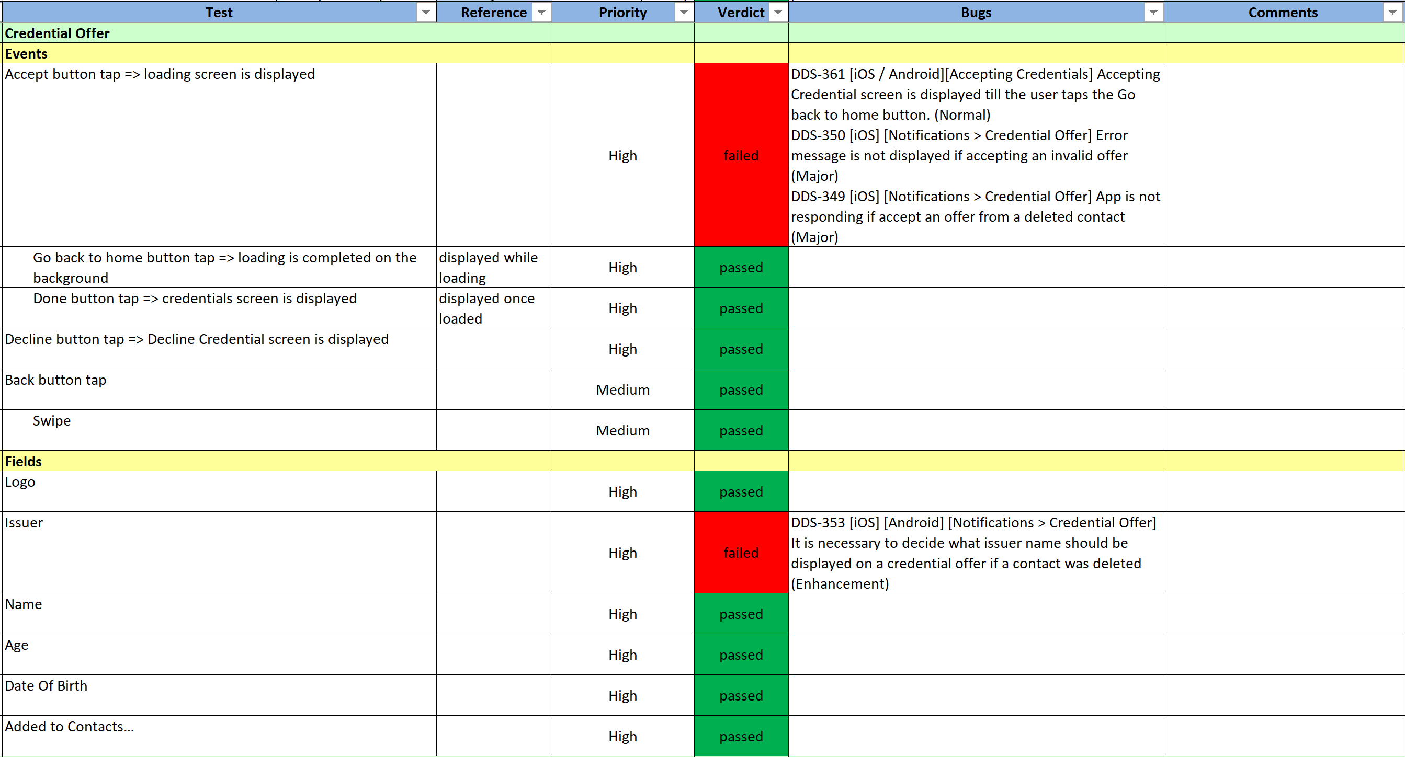
Credential Offer

Slide 10
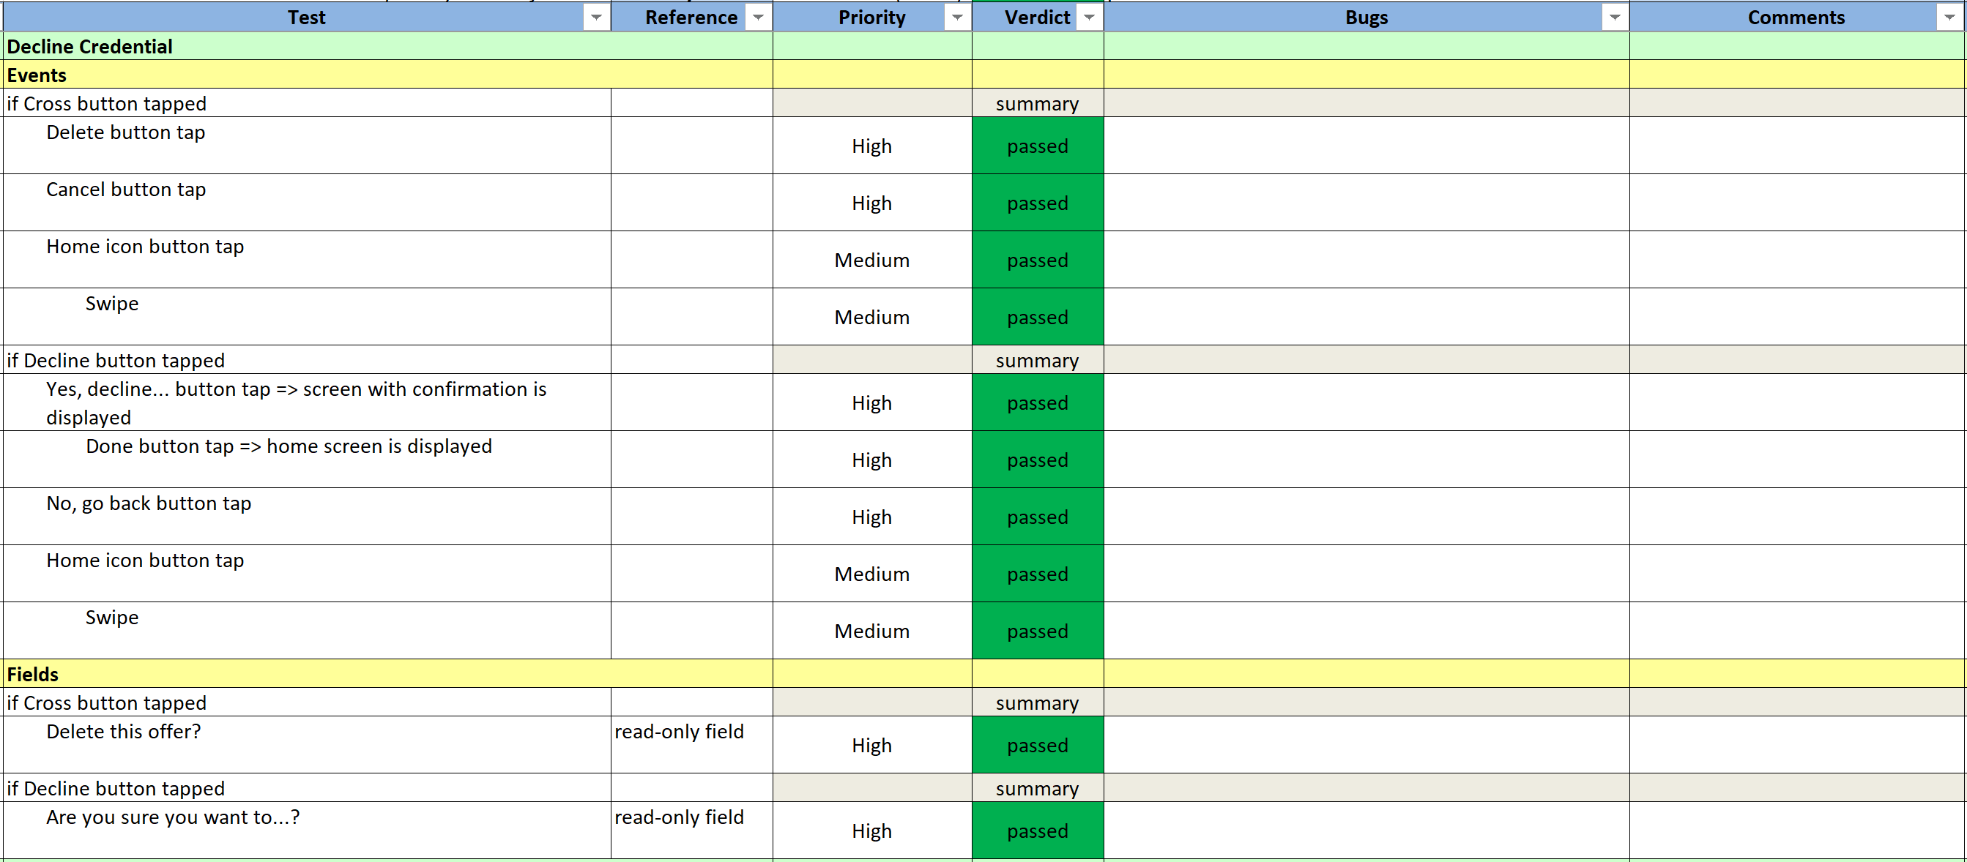
Decline Credential

Slide 11
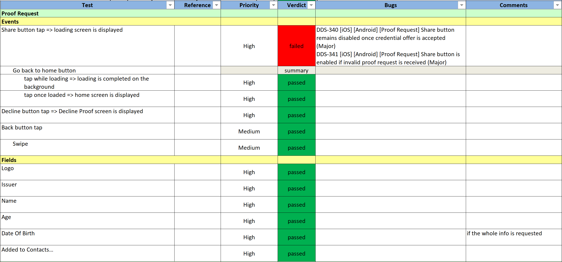
Proof Request

Slide 12
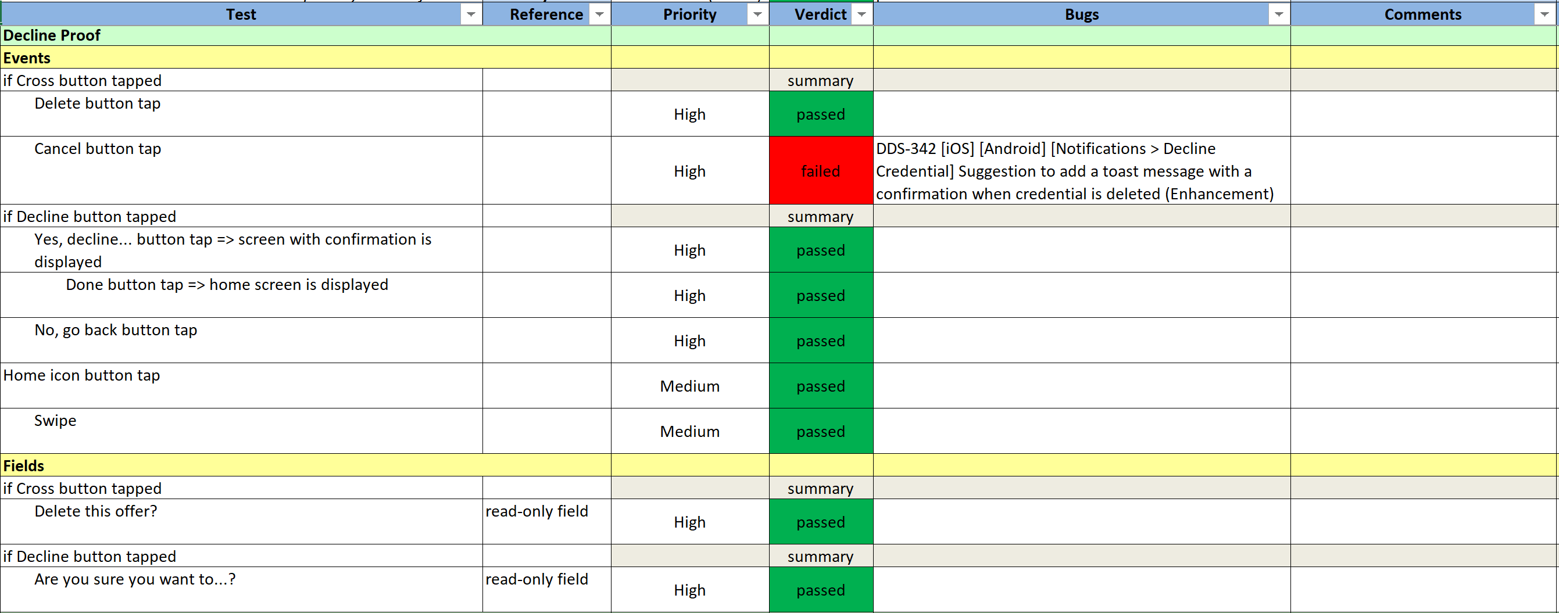
Decline Proof

Slide 13
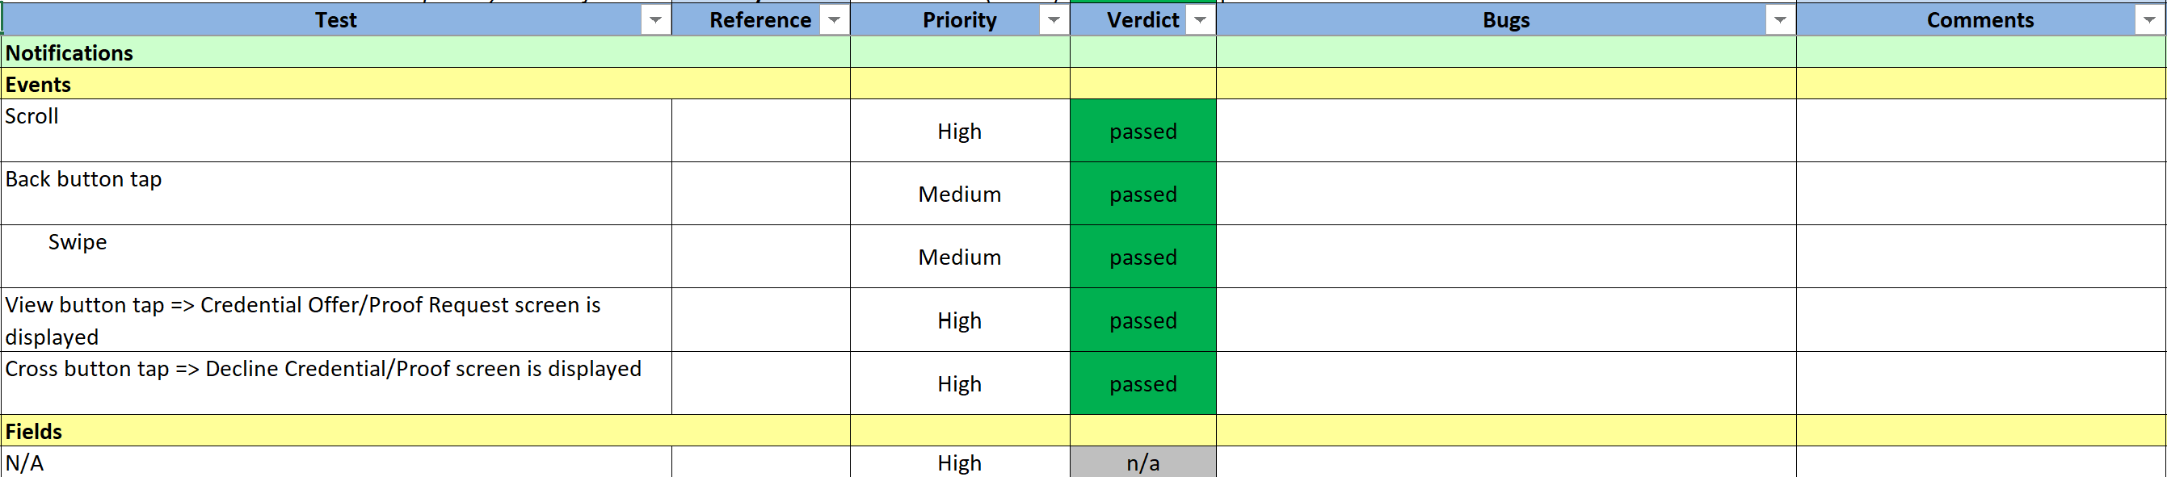
Notifications

Slide 14
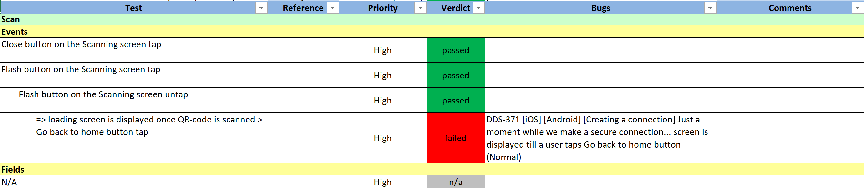
Scan

Slide 15
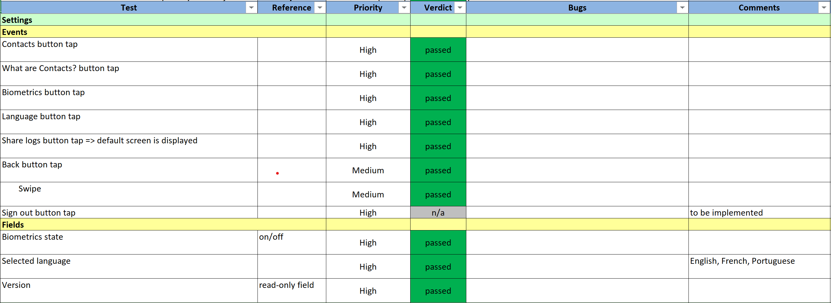
Settings

Slide 16
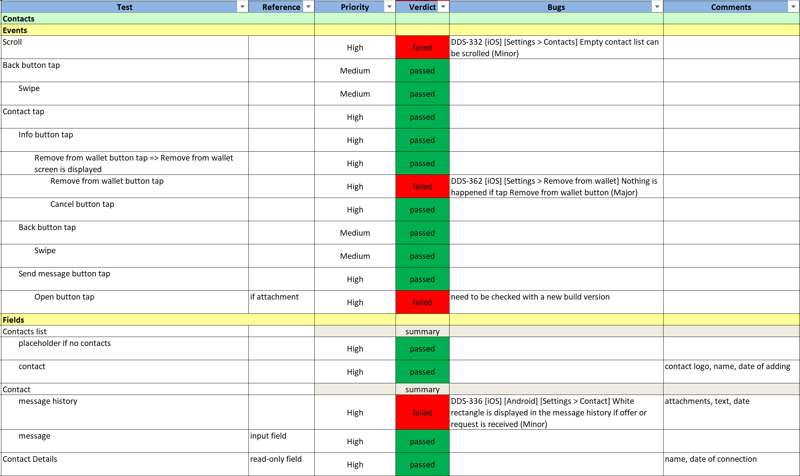
Contacts

Slide 17
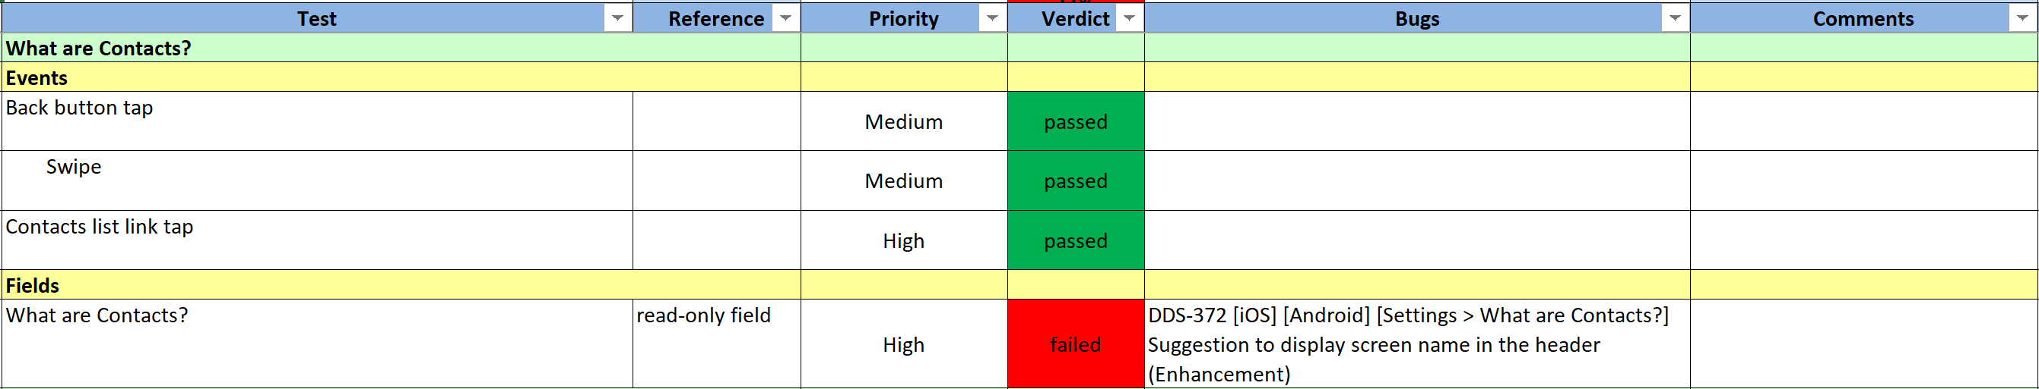
What are contacts

Slide 18
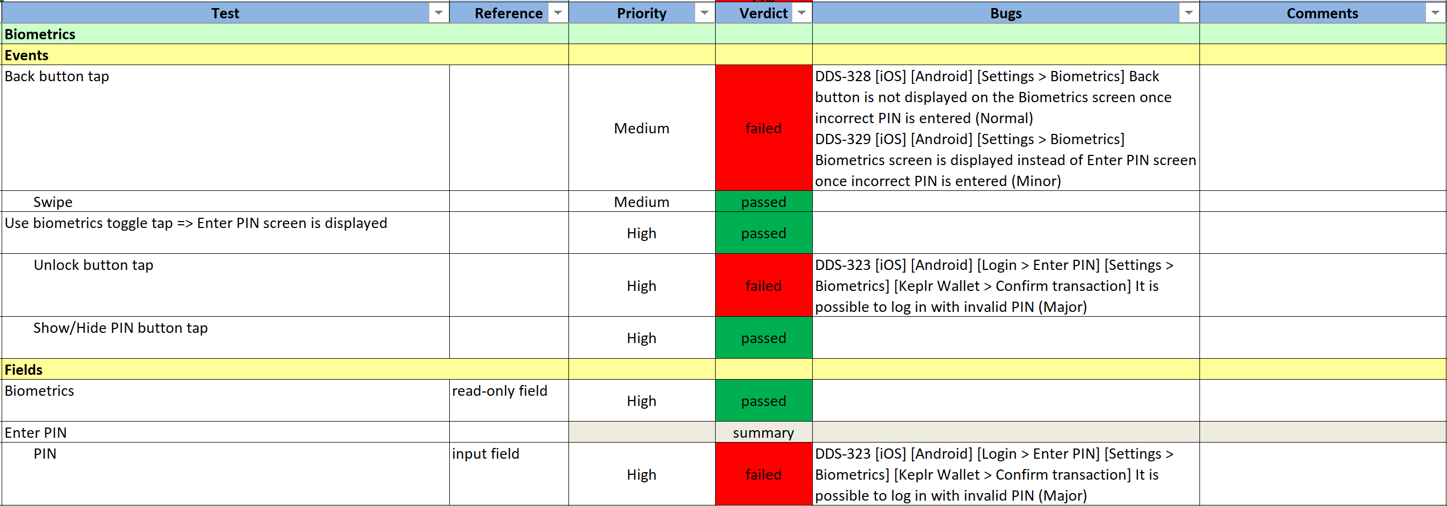
Biometrics

Slide 19
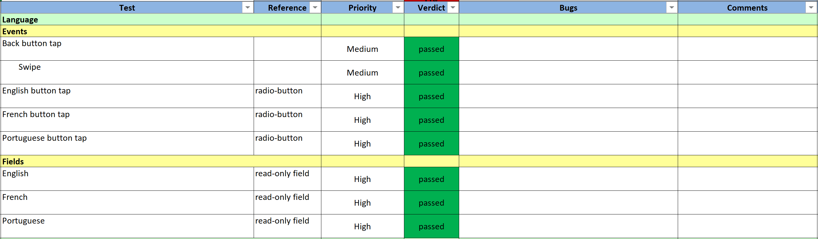
Language

Slide 20
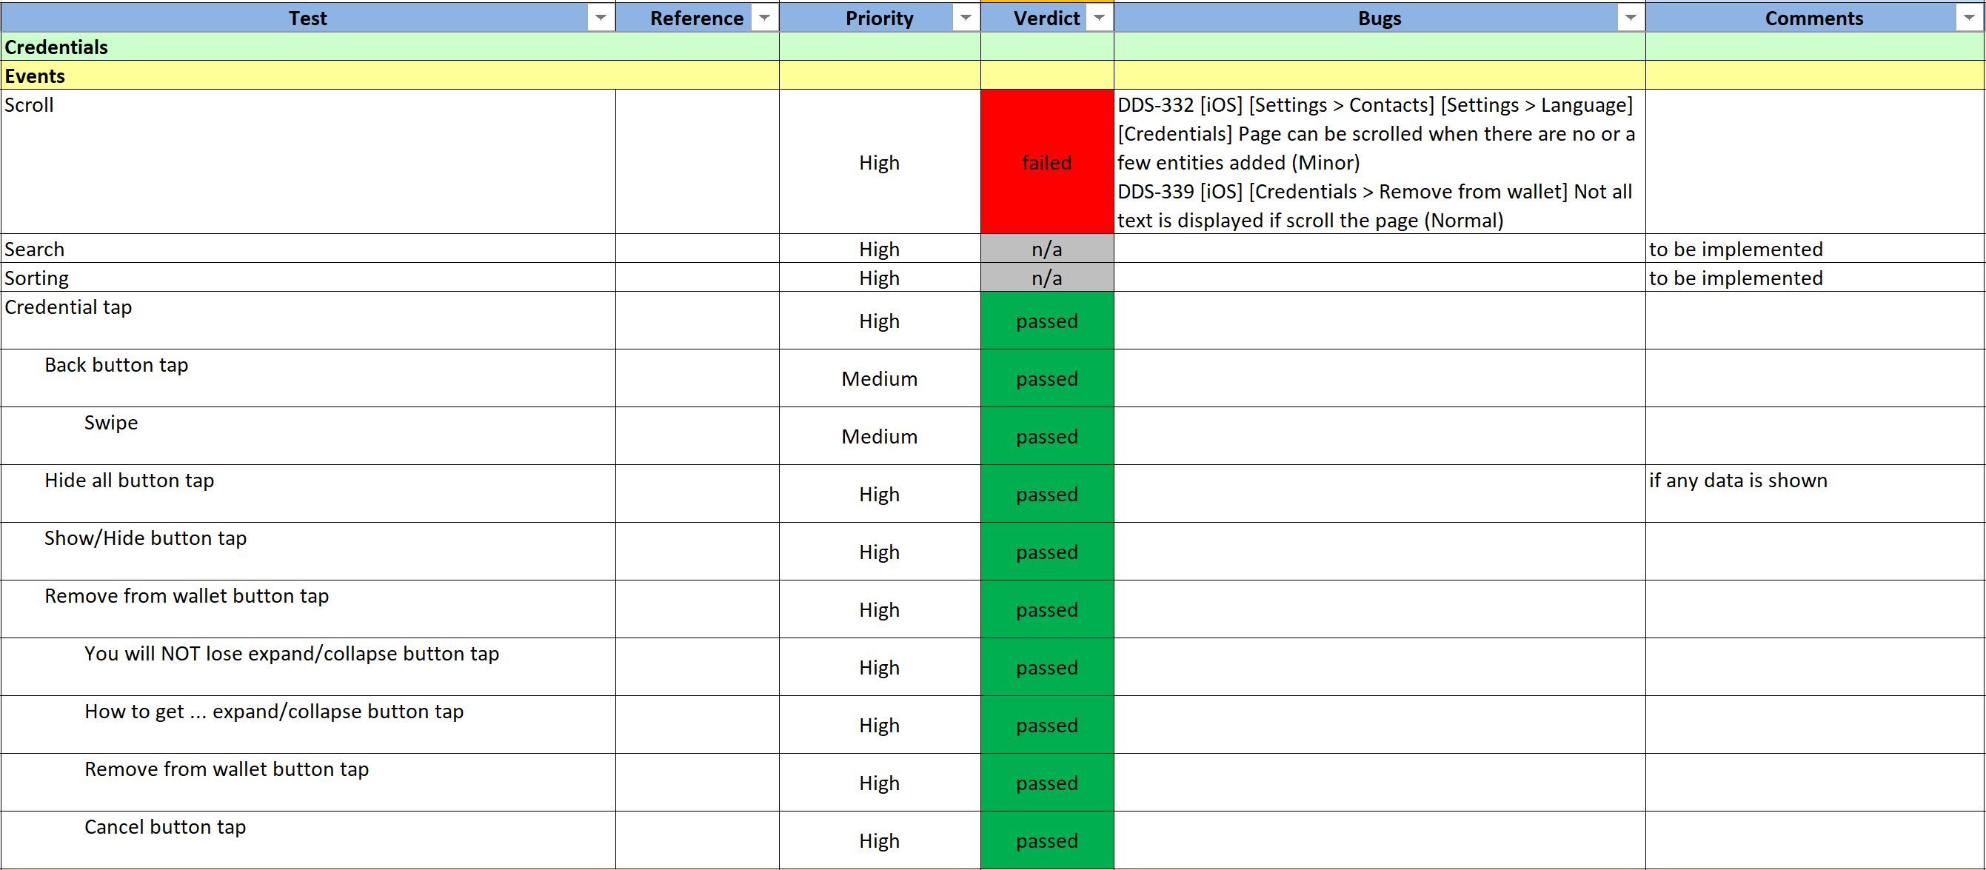
Credentials (events)

Slide 21
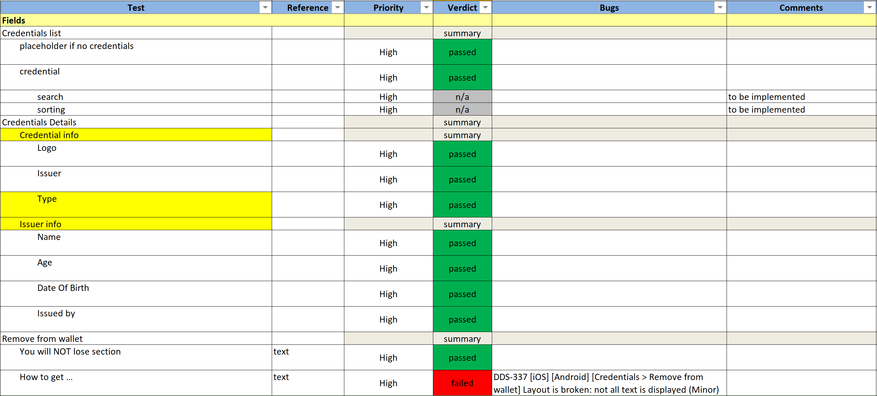
Credentials (fields)

Slide 22
Results
Found more than 20 bugs in total
Most significant bugs are related to login/PIN input, error handling and VC flow edge cases (for example, receiving messages from deleted contact)
Notes:
Edit images: No
The images are taken from the specifications (see references)

Slide 23
Next steps
Bugs classification by community and internal products
Double check existing GH issues and create new
Help with fixes
Notes:
Edit images: No
The images are taken from the specifications (see references)

Slide 24

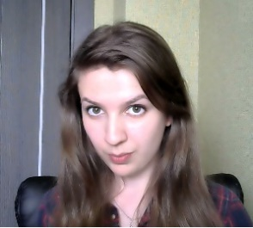
Alexander Shenshin
Senior Software Engineer
alexander.shenshin@dsr-corporation.com
Renata Toktar
Lead Software Engineer
renata.toktar@dsr-corporation.com
www.dsr-corporation.com
www.dsr-iot.com

